Slide 1

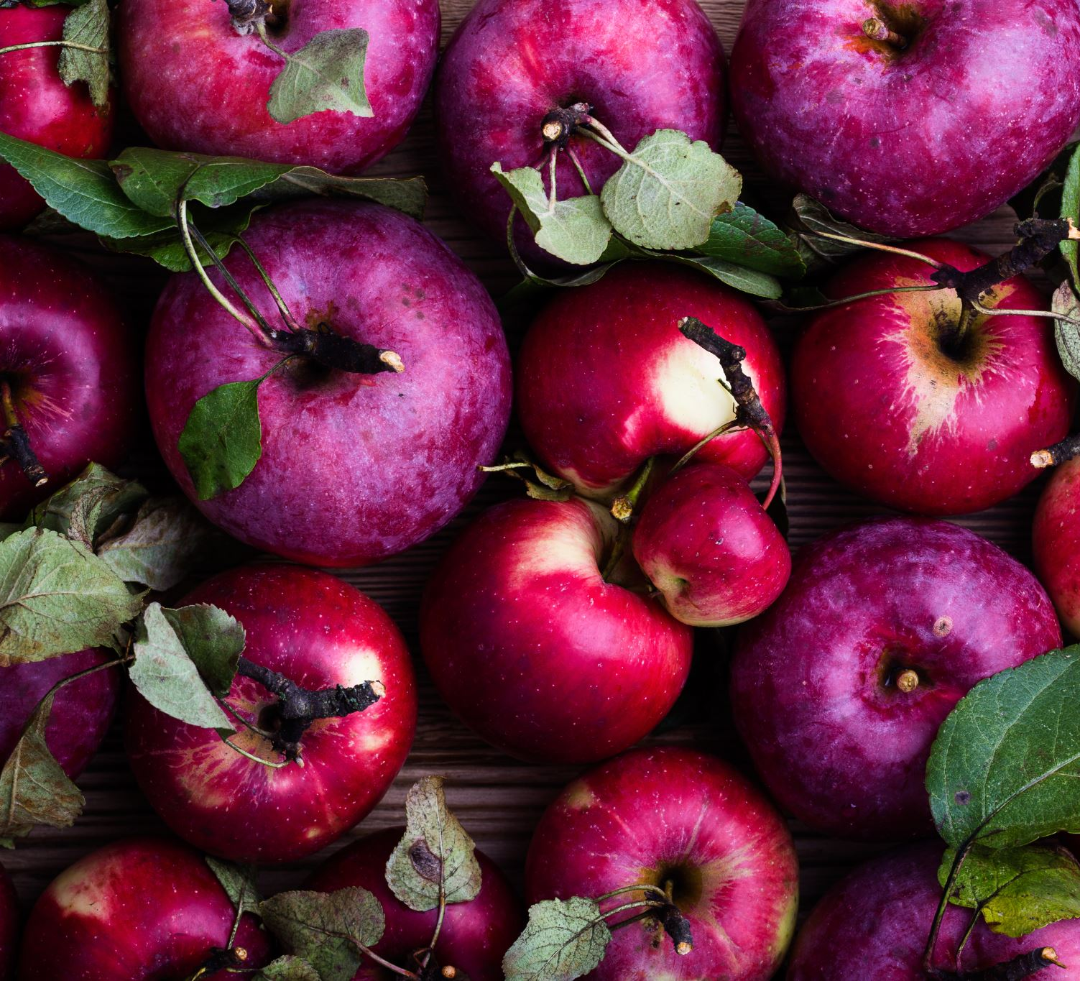
Apple Rhizosphere Communities out of Dysbiosis
How rootstock genotype may influence apple rhizosphere communities in an organic orchard

Slide 2
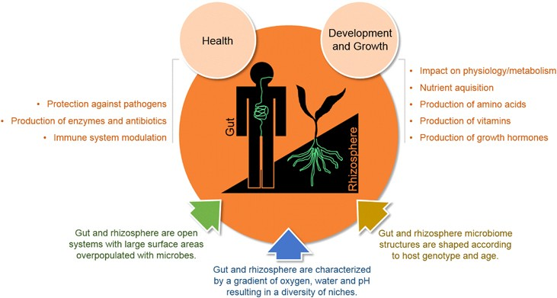
Guts and Plant Rhizosphere Perturbations -> Dysbiosis -> Disease (Inflammatory BD/ARD)
Figure 1. Similarities between gut and rhizosphere microbiome Taken from Mendes and Raaijmakers 2015.

Slide 3
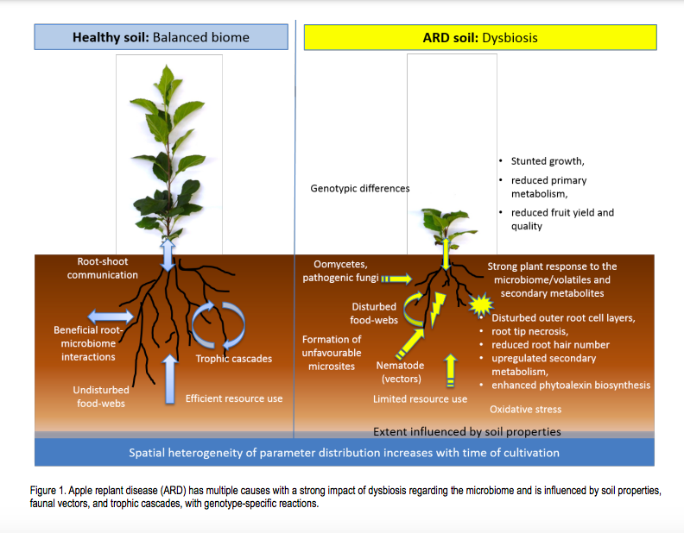
Apple Replant in a nutshell
Etiology is still unclear after over a century: Fungal pathogens, (and nematodes), Bacterial moderators?
Beneficial Bacillus, Pseudomonas, Actinobacteria- correlated both +/- with growth
ARD can result in 50% loss of profitability
ARD is on the rise worldwide due to intensification apple growing systems and land scarcity
Current practice involves fumigation ☹
Resistant Rootstocks and microbes offer possibility
Figure 2. The dysbiosis of Apple Replant Disease
Taken from Winkelmann et al. 2019.

Slide 4
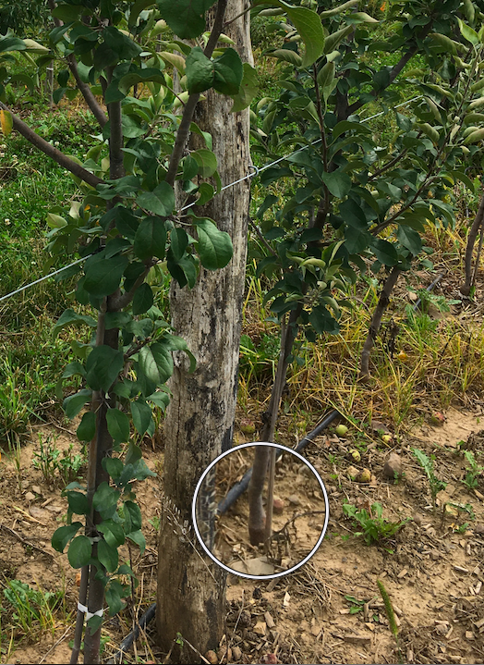
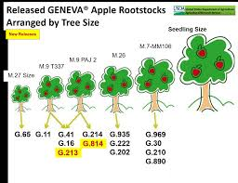
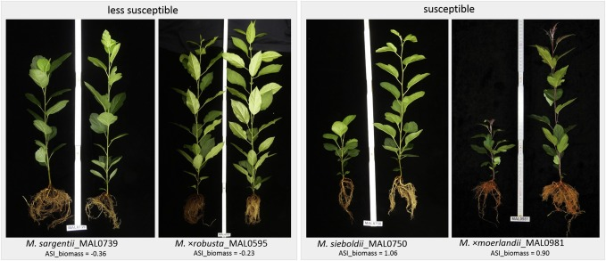
Apple Rootstocks
What are?
Resistant v. Susceptible
Geneva

Slide 5

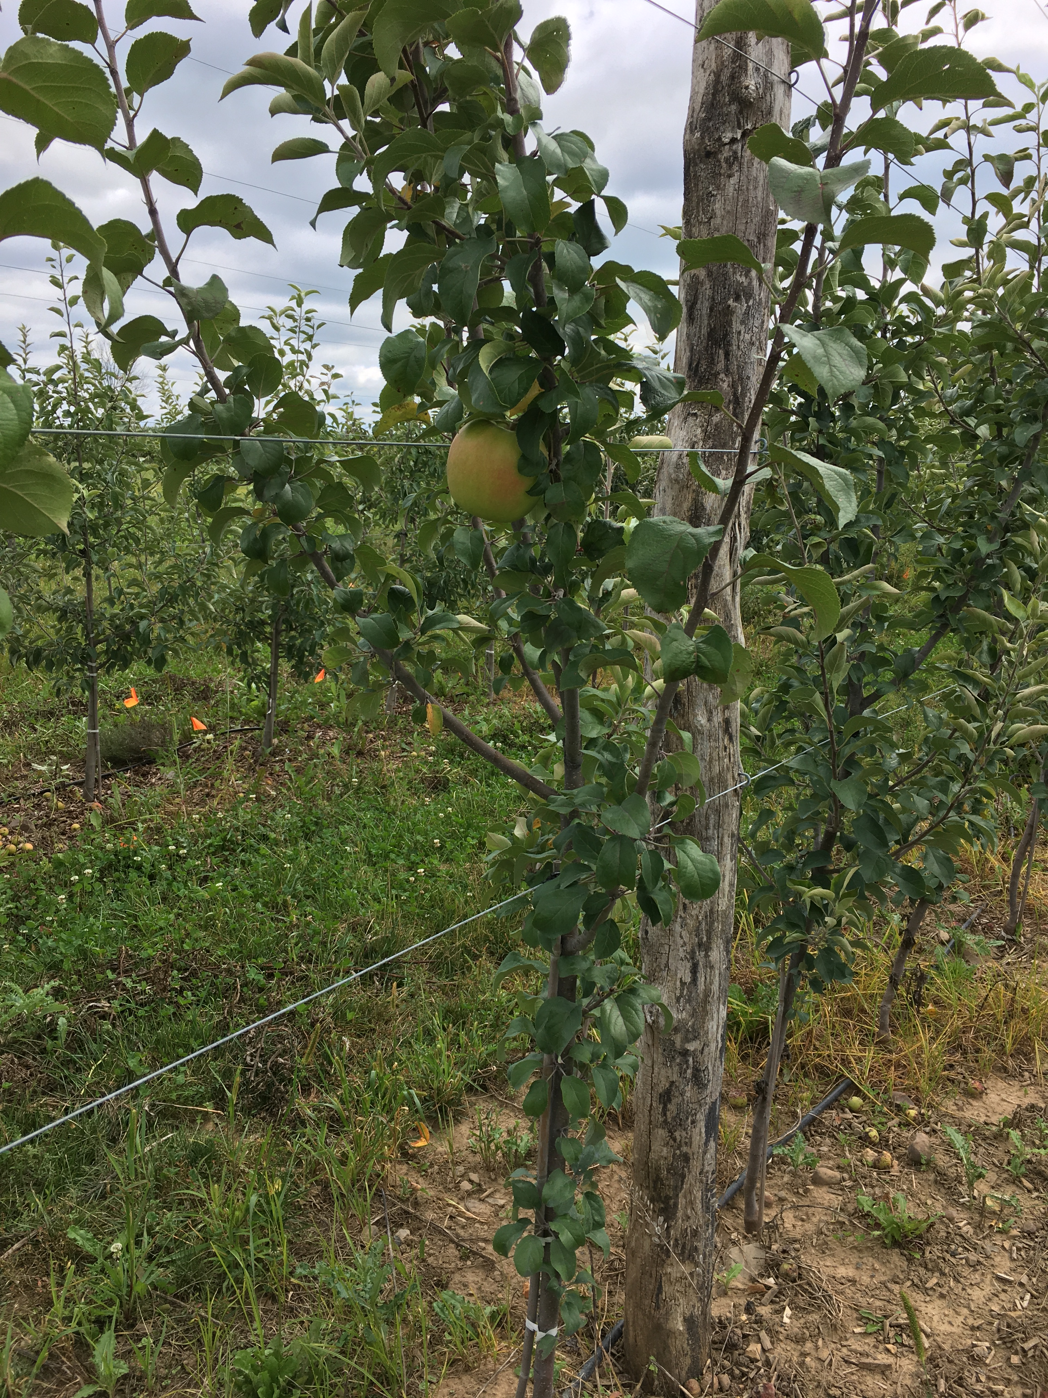
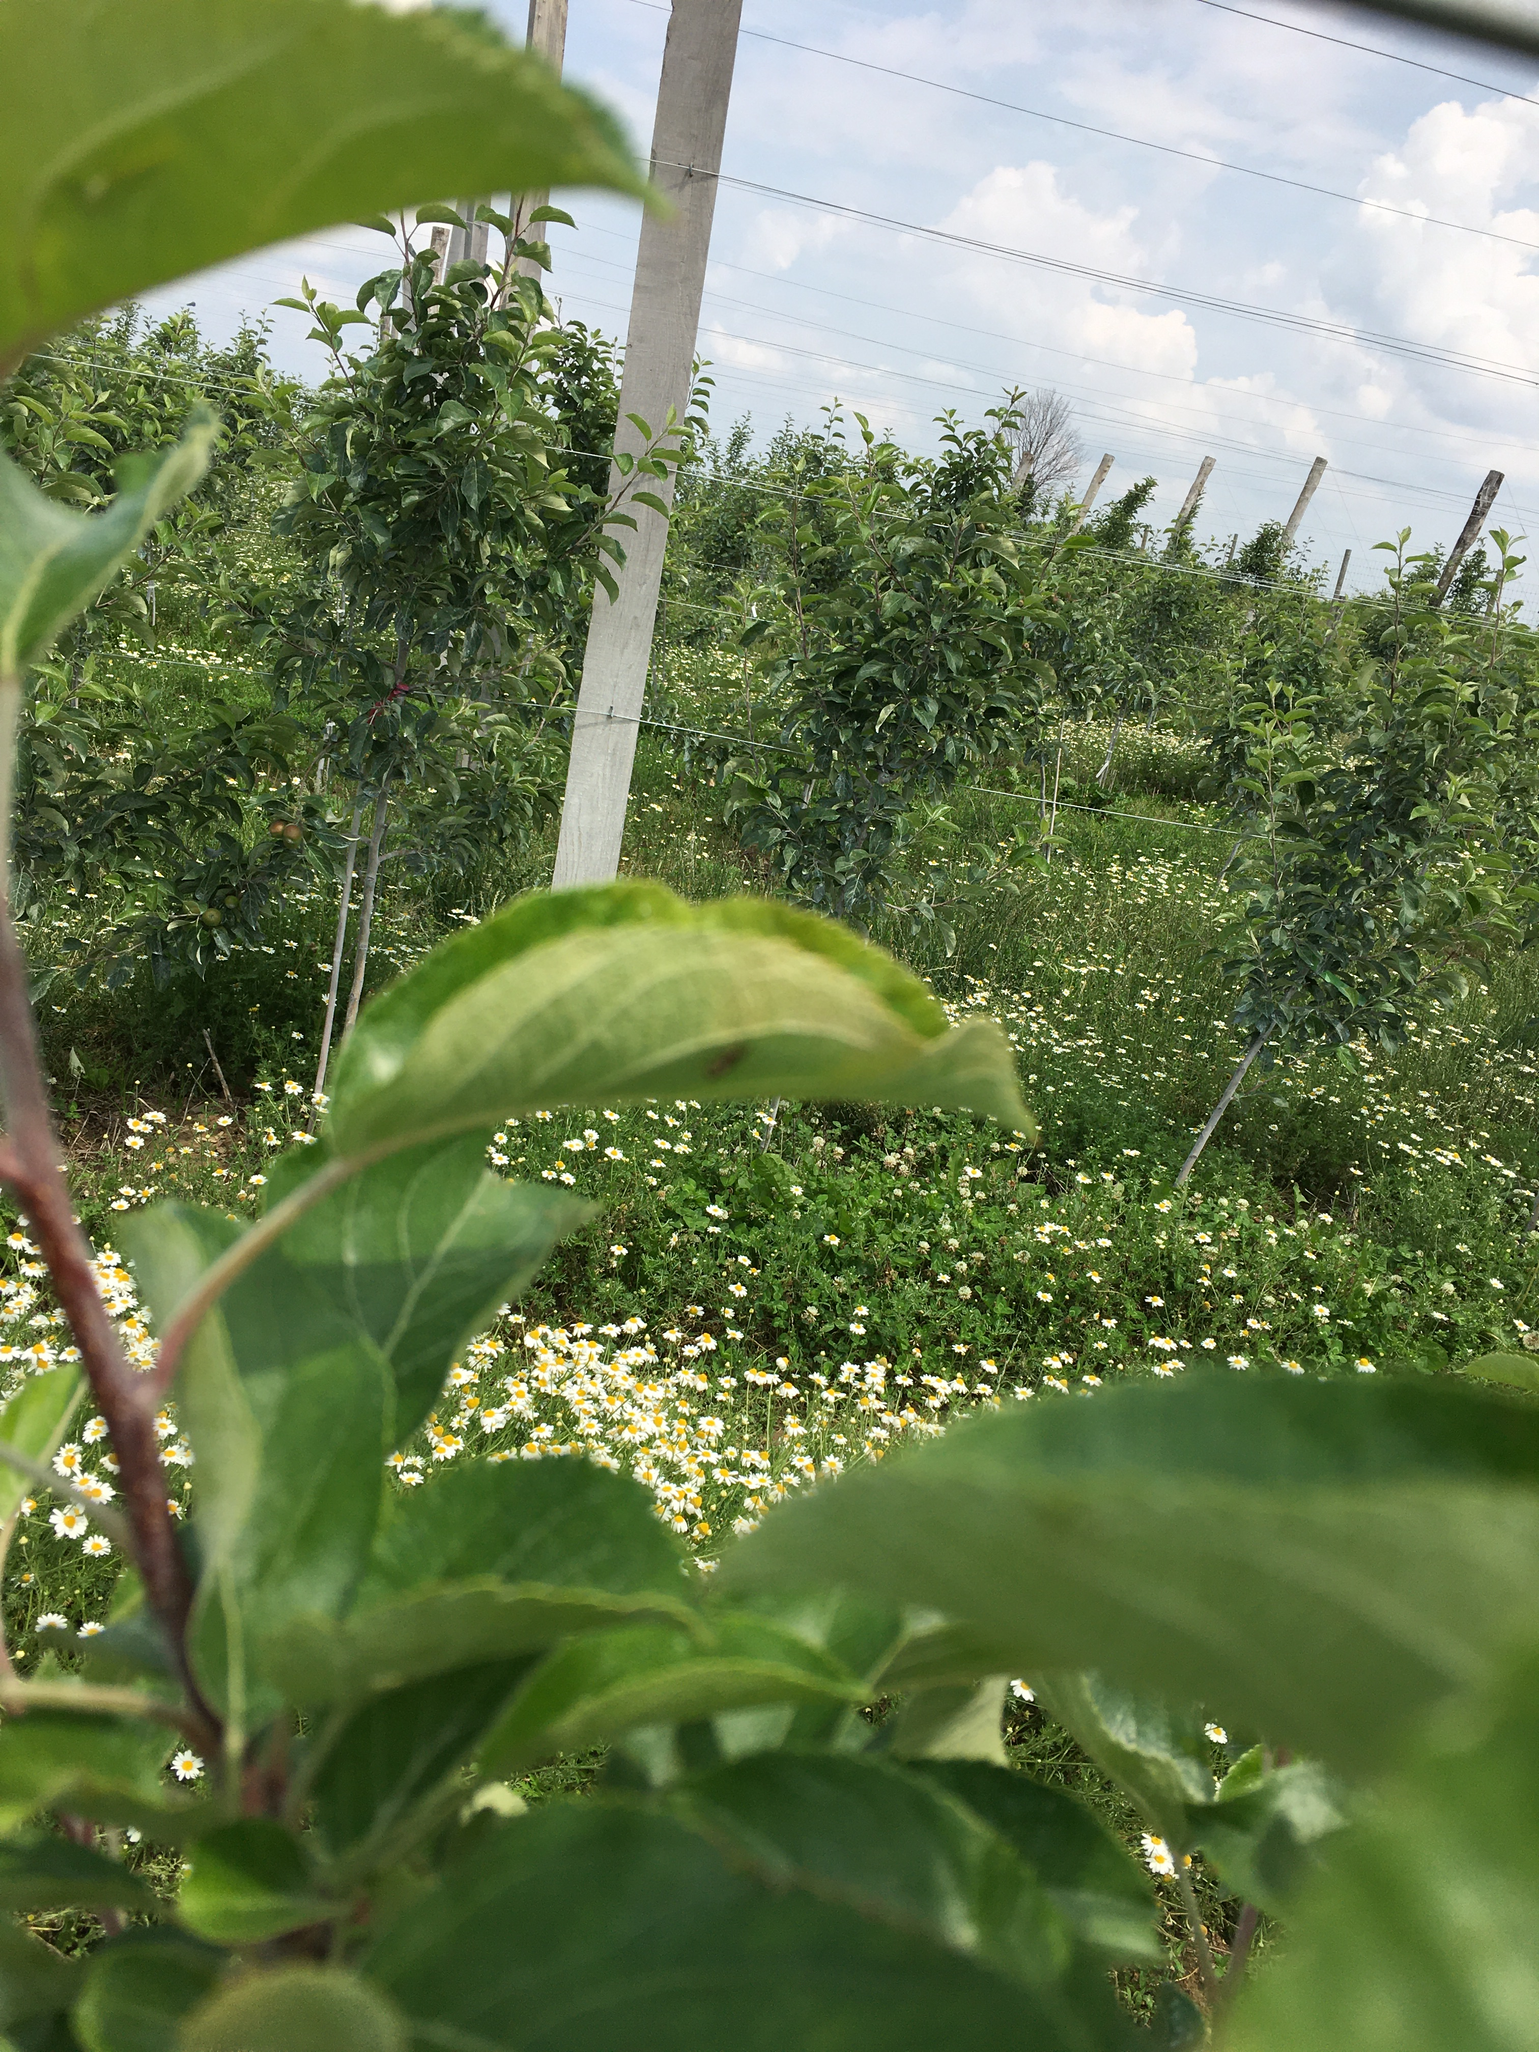
Organic growing system Increased microbial abundance and activity In an organic system, how to rhizosphere microbial communities differ based on apple rootstock genotype and ARD resistance?

Slide 6
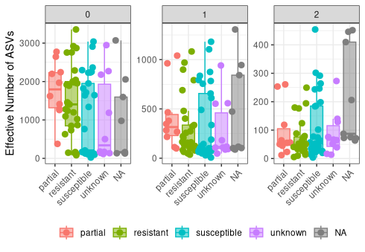
Resistant rootstocks appear to have greater richness, but less evenness than susceptible rootstocks

Slide 7
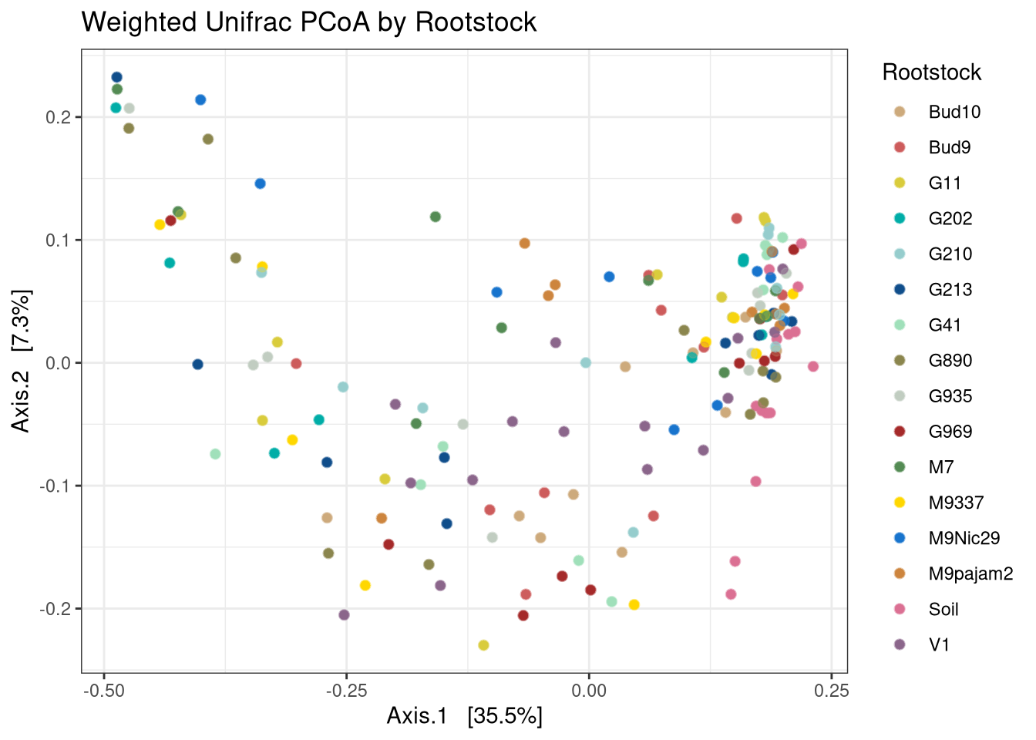
Rootstock has some influence on variation in microbial communities based on abundance and phylogeny PERMANOVA (R²=12%, F=1.2, p=0.001)

Slide 8
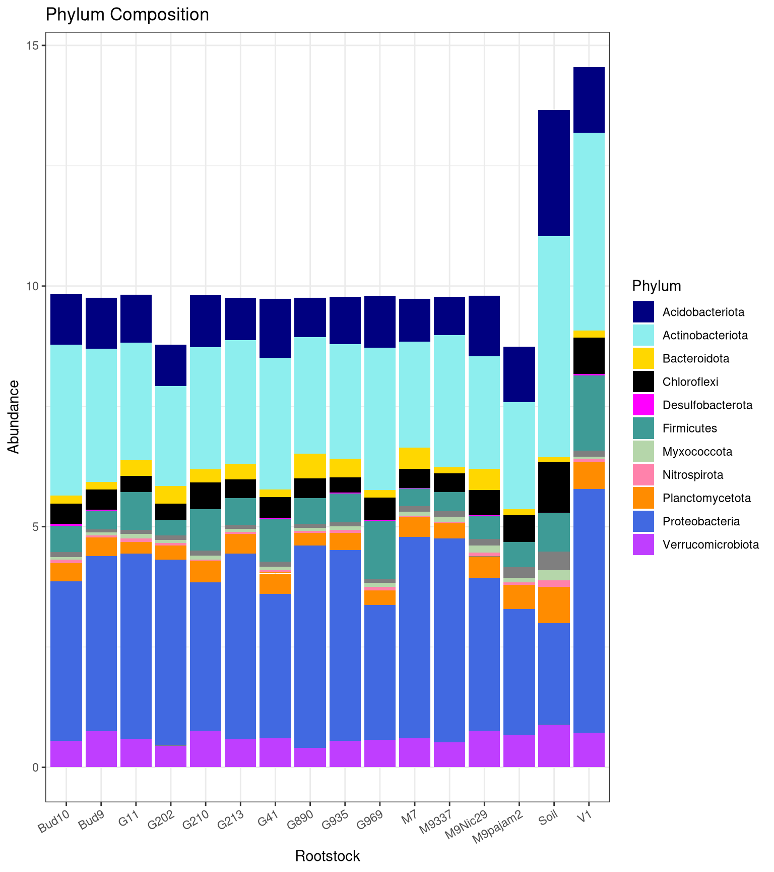

Soil and rootstock V1 appear to differ most in relative abundance, but stats needed
Actinobacteria
Chloroflexi
Verrucomicrobiota
Firmicutes

Slide 9
References
1. Blum, W. E. H., Zechmeister-Boltenstern, S., & Keiblinger, K. M. (2019). Does Soil Contribute to the Human Gut Microbiome? Microorganisms, 7(9), 287.
2. Mendes, R., Raaijmakers, J. (2015). Cross-kingdom similarities in microbiome functions. ISME J 9, 1905–1907
3. Cuevas-Sierra, A., Milagro, F. I., Aranaz, P., Martínez, J. A., & Riezu-Boj, J. I. (2021). Gut Microbiota Differences According to Ultra-Processed Food Consumption in a Spanish Population. Nutrients, 13(8), Article 8.
4. Winkelmann, T., Smalla, K., Amelung, W., Baab, G., et al. (2019). Apple Replant Disease: Causes and Mitigation Strategies. Current Issues in Molecular Biology, 30(1), 89–106.
5. Lori M., Symnaczik S., Mäder P., De Deyn G., Gattinger A. (2017). Organic farming enhances soil microbial abundance and activity—A meta-analysis and meta-regression. PLoS ONE.
6. Reim, S., Siewert, C., Winkelmann, T., Wöhner, T., Hanke, M.-V., & Flachowsky, H. (2019). Evaluation of Malus genetic resources for tolerance to apple replant disease (ARD). Scientia Horticulturae, 256, 108517. https://doi.org/10.1016/j.scienta.2019.05.044
7. R Core Team (2023). _R: A Language and Environment for Statistical Computing_. R Foundation for Statistical Computing, Vienna, Austria. <https://www.R-project.org/>.

